Slide 1
An Efficient Algorithm For Pickup and Delivery Problems With Ride-sharing and Multiple Transfers

Slide 2
Primary & Secondary Fig.1
DC
(dispatching center)
Travel information
(start,end,start time,*end time)
Request information
(start,end,start time,*end time)
supply
demand

Slide 3
Primary & Secondary Fig.2
DC
(dispatching center)
Schedule
Respond
(accept or not)
supply
demand

Slide 4
Primary & Secondary Request
 | Primary Request/ (Car) | Secondary Request/ (Request)
Role | Supply | Demand(rider, 小貨物)
Interact with DC | Send trip information to DC | Send request to DC
Satisfaction | Guaranteed | To be matched
Travel Path | Shortest path between its start and end | The path on which it can reach its end as soon as possible

Slide 5
Transfer Fig.
Temporary
storage
Transfer node
Loading car
Unloading car

Slide 6
Temporary Storages for transfer
Background
Large population moving into cities
Dense Cities in Asia
The emergence of autonomous cars (Automation and lower cost for transfer)
Improve road and car space use with transfer and ride sharing
Supplies cooperate to satisfy demand
More ridesharing opportunities without adding new cars or altering original routes

Slide 8
Time window
EAT
(early arrival time):
The earliest time on which the car can reach the node
LDT
(late departure time):
The latest time on which the car must leave the node
Time window
car
node

Slide 9
Flexibility on time window
Extend time window so as to satisfy more demands
End time = start time + (shortest travel time)*flexibility
Ratio vs constant amount of slack
Wait(use flexibility):
1) demand wait at a node for supply to pick it up
2) supply wait for transfer cases

Slide 10
Flexibility-wait(transfer case) Fig.
Temporary
storage
Loading car wait at transfer point for unloading car to arrive
Unloading car
Transfer point
Loading car

Slide 11
Comparisons
Comparison with general Pickup and Delivery Problem
Comparison with Ridesharing (Uber and DD car)

Slide 12
 | Our research | General PDP
Supply | Own by car owners | Own by DC
Supply’s path | Preassigned(according to car owner’s traveling plan) | Assigned by DC
Supply’s start and end | Preassigned(according to car owner’s traveling plan) | Start & end at depot
Supply’s availability | only in time window
transfer | At every intersection | At certain vertexes( PDP with Transfer)
flexibility | For both supply and demand | ?

Slide 13
 | Our research | Ridesharing (Uber/DD)
Supply | Own by car owners | Taxi car pool
Supply’s path | Preassigned(according to car owner’s traveling plan) | Present passenger’s travel plan
transfer | At every intersection | x

Slide 14
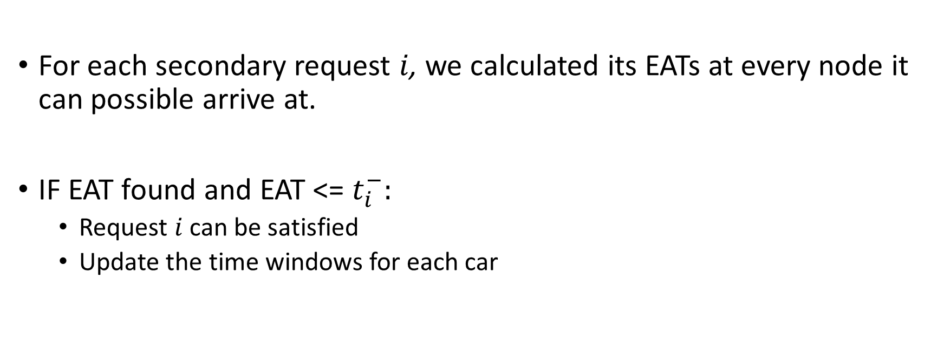
The Minimum EAT First Algorithm
For each secondary request $i$, we calculated its EATs at every node it can possible arrive at.
IF EAT found and EAT <= $t_{i}^{−}:$
Request $i$ can be satisfied
Update the time windows for each car

Slide 15
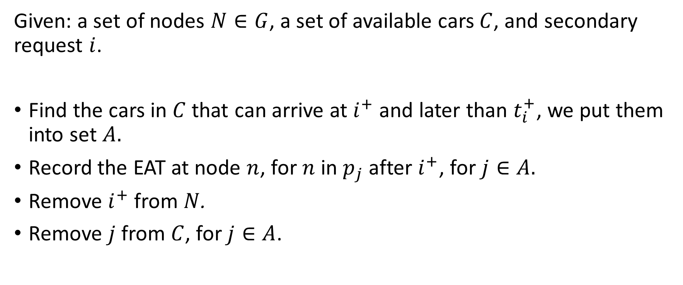
Algorithm Design - Initialization
Given: a set of nodes $N∈G$, a set of available cars $C$, and secondary request $i$.
Find the cars in $C$ that can arrive at $i^{+}$ and later than $t_{i}^{+}$, we put them into set $A.$
Record the EAT at node $n$, for $n$ in $p_{j}$ after $i^{+}$, for $j∈A.$
Remove $i^{+}$ from $N$.
Remove $j$ from $C$, for $j∈A$.

Slide 16
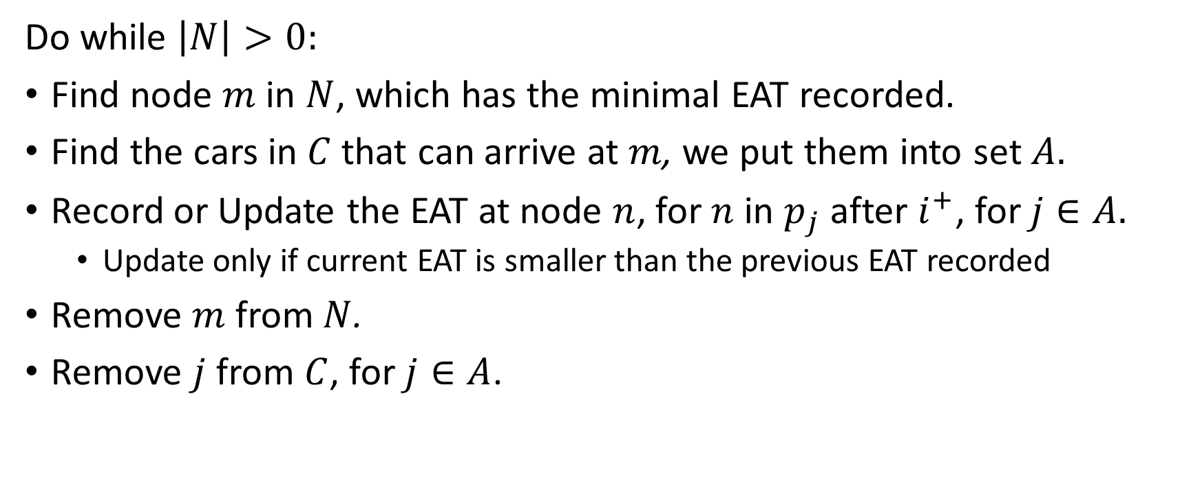
Algorithm Design - Iteration
Do while $\left|N\right|>0:$
Find node $m$ in $N$, which has the minimal EAT recorded.
Find the cars in $C$ that can arrive at $m$, we put them into set $A.$
Record or Update the EAT at node $n$, for $n$ in $p_{j}$ after $i^{+}$, for $j∈A.$
Update only if current EAT is smaller than the previous EAT recorded
Remove $m$from $N$.
Remove $j$ from $C$, for $j∈A$.

Slide 17
Car 2 Path
Update EATs
20
V6
20
Repeat until no nodes are left
7
V5
7
7
5
10
12
5
10
15
20
Start
V1
V2
15
20
V3
V4
Car 1 Path
Car 3 Path

Slide 18
Numerical Testing
Dataset: Chicago Taxi
Day Jan1 – Jan21
Parameters
Primary Request Flexibility = 1.2
Seconday Request Flexibility = 1.5
Primary to secondary request ratio = 2

Slide 19
Preprocessing Chicago Graph
We use the center points the 77 Chicago community areas as are nodes
An edge exists between two community areas adjacent to each other.
Use Google map Distance Matrix API to calculate edge weights (travel time)
Graph property(how does this effect our result)
77 nodes
Edges
Undirected

Slide 20
Preprocessing Chicago Taxi Dataset
pickup and dropoff locations
clustered into the center points the 77 Chicago community areas
pickup time we randomly adds range(900) seconds to the pickup time
Drop-off time = pickup time + distance*flexibility(parameter)
Average speed?

Slide 26
Number of available cars & Feasibility

Slide 27
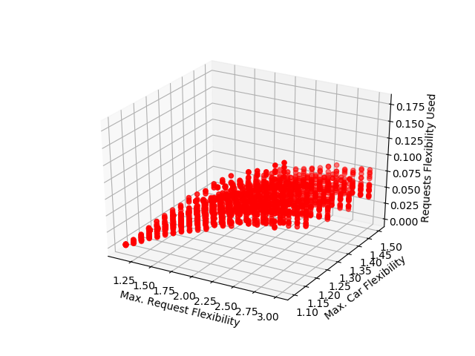
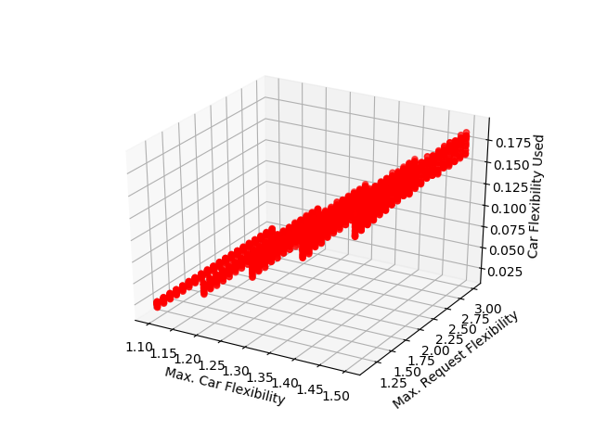
Car Flexibility and Car waiting time

Slide 28
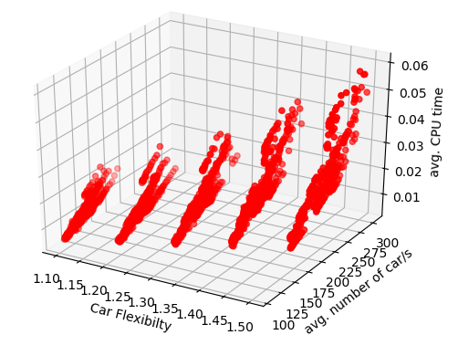
Algorithm Speed
(s)

Slide 29
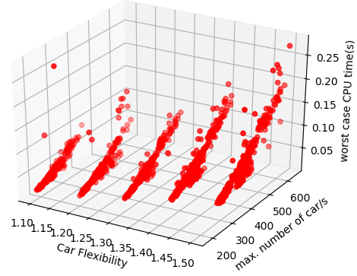
Worst Cases

Slide 30
Performance on Realistic Scenario
Request Flex = 1.5
Car Flex = 1.2
78 % Secondary Request Satisfied
5.7% feasible transferred
Save 26% rides
Waitime

Slide 31
Conclusion
Transfer and time flexibility can create more secondary ride opportunities.
Lowering the cost for each transfer is important to increasing car and road space use in cities.
Min EAT first algorithm for online matching.

